Slide 1
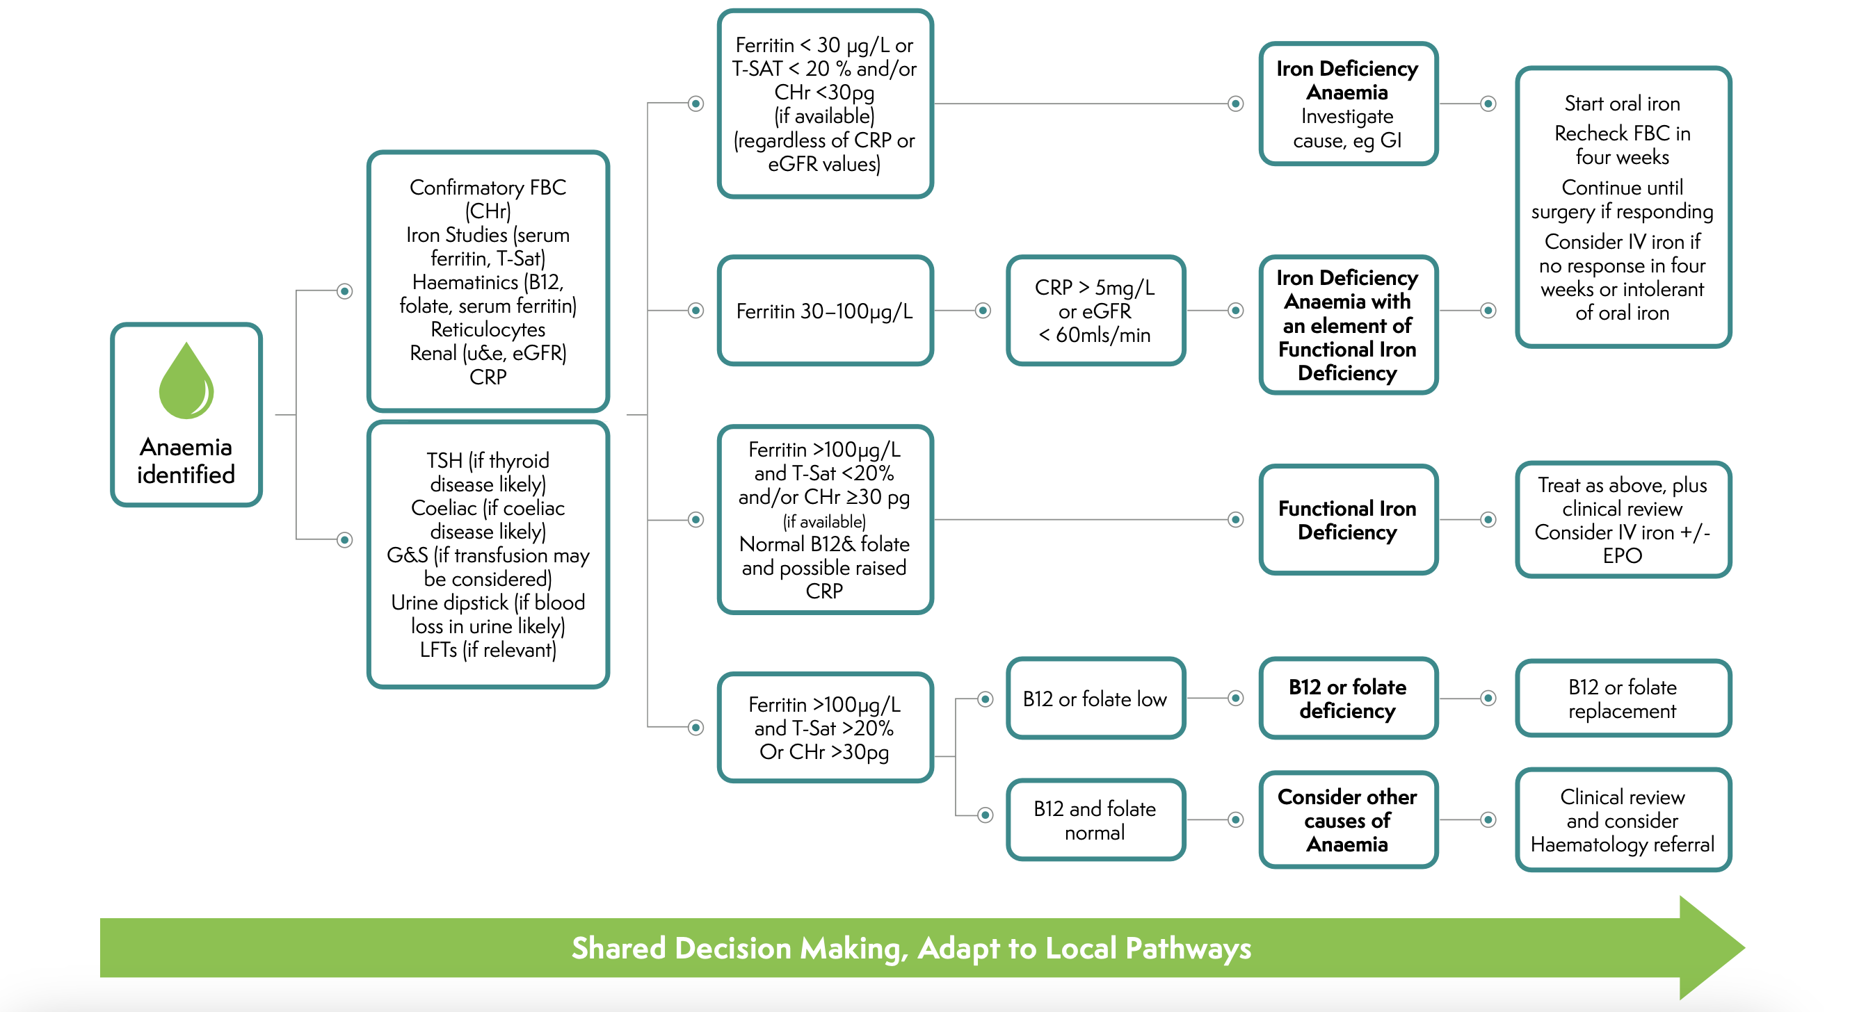
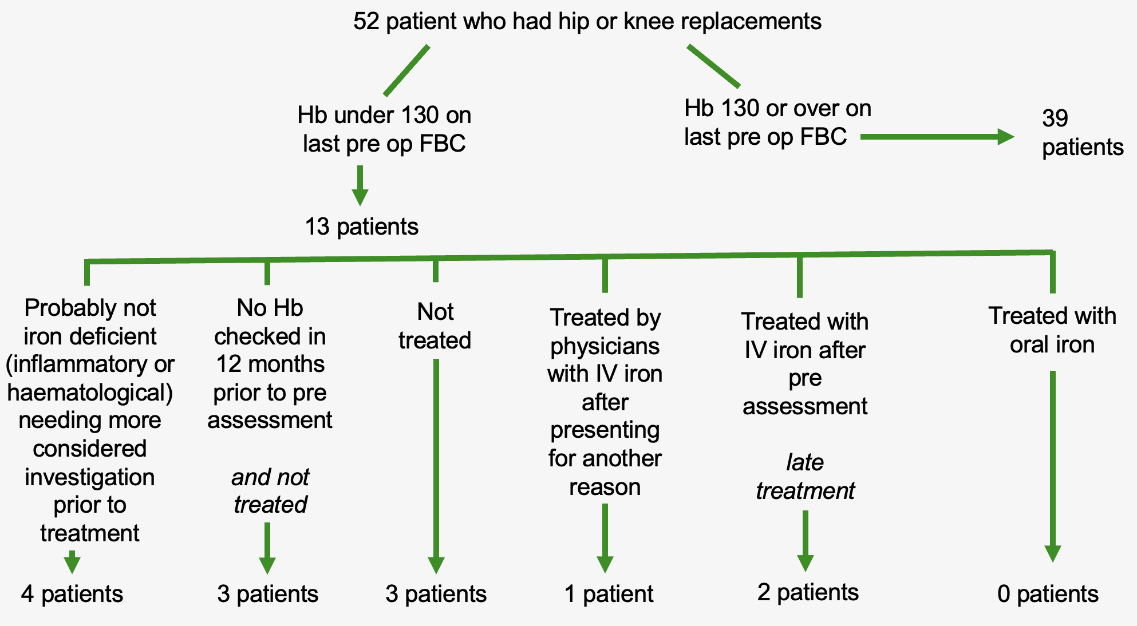
Impact of pre-operative anaemia on elective patients
K MEHTA¹, Dr K TEARE²
Lancaster University, Lancaster, United Kingdom
Noble’s Hospital, Douglas, Isle of Man
INTRODUCTION
RESULTS
DISCUSSION
Anaemia is a very prevalent condition that is defined as Haemoglobin (Hb) below 130 (Male and Female). (1)
Most commonly due to iron deficiency.
Perioperatively it can increase risk of complications by two to three times – independently 20% increase
Centre for perioperative care (CPC) has released guidance on the management of this including: (2)
Should be found and managed early
All who meet testing criteria should have FBC
All who have finding of anaemia should have a documented cause
Overall
52 patients identified – 25% anaemic
36 patients had an incidental FBC on record within the year before their surgery - of these, 12 were anaemic
There were 16 patients with no recent FBC prior to the pre-operative clinic – some of these were also found to be anaemic
See Figure 2 for more detail
Post-operatively
Pre-operative anaemic
range 94 – 125, mean = 113
Non-anaemic patients
- Range 130 -161, mean = 143
Mean peri-operative drop Hb = 21
Individual cases where Hb <130 on an incidental FBC
Case 1 – 72 yo
Rheumatoid arthritis
Iron studies conducted previous years, showing deficiency with treatment
Within the past year, no iron studies or supplements prescribed / taken
Post-operative Hb 80
Case 2 – 83 yo
Significant IHD
No iron studies conducted
Despite anaemia noted during clinic, no action taken
Post-operative Hb 87
Blood transfusion given in ED one month after, followed by IV iron infusion days later
Case 3 – 77 yo
Paroxysmal AF
Incidental Hb noted, iron studies then conducted through pre-assessment
IV iron given but response not assessed
Reasons
Unaware that blood results are available – poor communication and documentation between the specialities
Blood results system poorly highlights deranged Hb according to previous guidance – womens v mens range, does not match this guidance, easy to miss result is not normal
Improvements and suggestions made
Increased awareness - more cases regarding this issue reported through pre-assessment clinics, aim to lead to improved treatment
At listing, existing bloods may be checked - this allows early diagnosis, thorough investigation and effective management whilst avoiding IV iron (1)
Stress that anaemia is Hb less than 130 for all even if this is not highlighted (2)
Aim to not rush any treatments – oral iron takes 4-6 weeks, IV iron requires up to 4 weeks (3)
Encourage increased communication between specialities – tackles unawareness, prevents duplication
Reassess this issue – complete this project again, review improvements and impact, consider the addition of elective general surgery
Figure 1: Centre for perioperative care pathway for managing anaemia (1)
AIM
Assess the prevalence of anaemia in patients undergoing elective surgery at Noble’s Hospital.
Analyse whether further action, such as checking blood results in elective patients before pre-operative clinics, would have any impact. Monitor whether treatment was initiated
Determine how closely the guidance from the CPC is adhered to
Discuss the reasons for the results found.
If there is potential, suggest reasonable actions and improvements.
Figure 2: Results depicting management of patients found to be anaemic at
pre-operative assessment clinic
METHOD
CONCLUSION
REFERENCES
ACKNOWLEDGEMENTS
Suitable patients were identified from the hospital’s theatre electronic system
The selection criteria was:
Elective total hip and knee replacements undertaken at Nobles Hospital, Isle of Man
Mid-August to Mid-November 2022 (3 months)
Following this, records were searched and these parameters were noted:
- Full blood counts (FBC) – taken within 12mo pre-operative clinic, pre-operative clinic, within hours of surgery, post-operatively
Hb below 130 at any stage
Further tests – e.g. iron studies
Evidence of management of anaemia was noted from the patients notes and clinic letters
The importance of anaemia in peri-operative care is paramount which was shown through this assessment of the extent to which practice at this hospital mirrors guidance.
The results found have shown the general pattern that anaemia could have been detected earlier due to many patients having incidental FBCs on system. Specifically evidenced in the three cases described.
Additional data shows that ensuring early blood testing for these patients may improve diagnosis and treatment of anaemia.
Suggested improvements were varied but there is a general push to check a patient’s blood results at listing for them to be referred to pre-assessment clinic early if there are any findings
A large thank you to the theatre lead who sourced the initial data. Also note the contributions to the anaesthetists and surgeons present at the hospital’s surgical Morbidity and Mortality meeting, where this project was discussed and where the recommendations were suggested.
Centre for Perioperative Care. Guideline for the Management of Anaemia in the Perioperative Pathway [Internet]. 2022 Sep [cited 2023 Mar 10]. Available from: https://www.cpoc.org.uk/sites/cpoc/files/documents/2022-09/1.%20CPOC_GuidelinefortheManagementofAnaemia_September2022.pdf
Hawkins T, Agarwal S, Evans CR. Centre for Perioperative Care anaemia guideline: implications for anaesthesia. British Journal of Anaesthesia. 2023 Feb;130(2):115–9.
Clinical Knowledge Summaries [Internet]. NICE. Available from: https://cks.nice.org.uk/topics/anaemia-iron-deficiency/management/management/
‌
1VBBBBBII
CONTACT INFORMATION
Krishna Mehta – Fifth Year Medical Student
k.d.mehta@lancaster.ac.uk
Dr Kate Teare – Consultant Anaesthetist

